Slide 1
GREENWICH HR PROJECT
Jake Atlas | Srividya Ganapathi | Daniel Halteh | Adi Tyagi
“Bryce Canyon”

Slide 2

PROJECT OVERVIEW – BRYCE CANYON
Correlation between ads, skills in ads and stock performance in next 90 days (by October 25)
Predictive models for stock price in the next 90 days based on ads and any other possible external public data set (first model by November 15)
Based on ads predictive models for stock outperformance in the next 90 days (end of the quarter)
Full Project
Association Analysis
Machine Learning Analysis
Unique Metric Method
True Statistical Correlation Method

Slide 3


ASSOCIATION ANALYSIS – UNIQUE METRIC METHOD

Slide 4
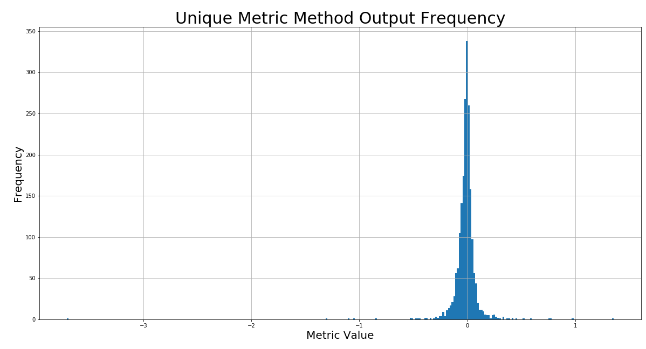
ASSOCIATION ANALYSIS – UNIQUE METRIC METHOD
Relatively 0-centered normal distribution with small tails
Standard deviation is 0.13
Outliers exist and are consistently penny-stocks

Slide 5

ASSOCIATION ANALYSIS – CORRELATION METHOD

Slide 6
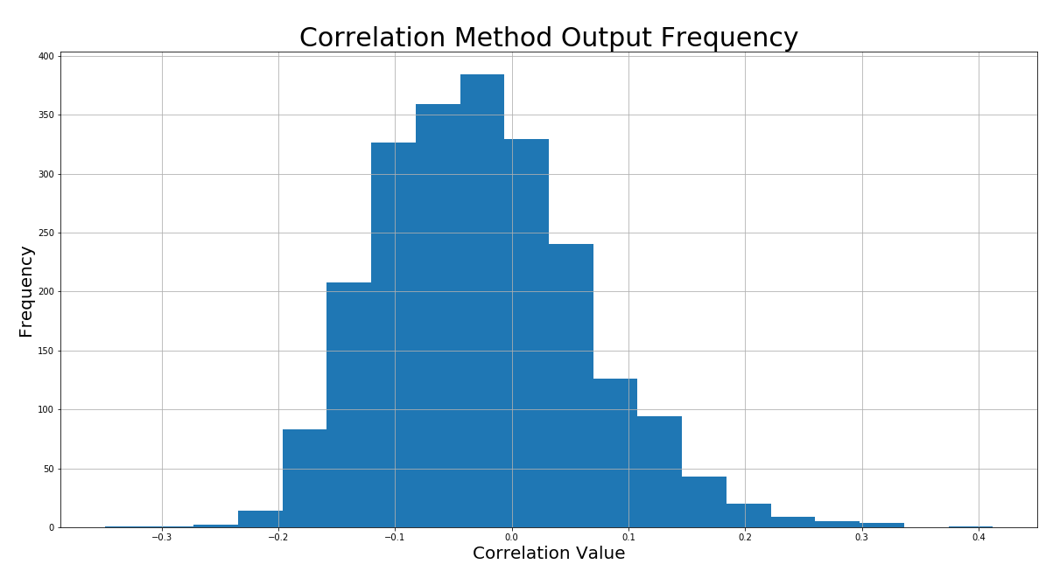
ASSOCIATION ANALYSIS – CORRELATION METHOD
Relatively 0-centered but skewed distribution with minimal tails
Standard deviation is 0.09
Mean and median are approximately equal despite apparent skew

Slide 7
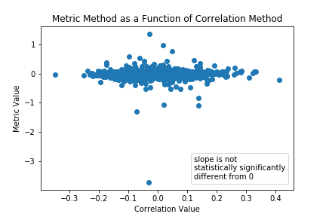
ASSOCIATION ANALYSIS – RECOMMENDATIONS
Beware of trying to pick stocks by using single numbers. This is likely not effective. Use these lists sparingly, and when using them, use both
Exercise extreme caution when considering investment in penny stocks
Create simulated portfolios to provide statistical significance for all values of interest, with regards to stock performance
Consider statistical testing to determine optimal window length

Slide 8
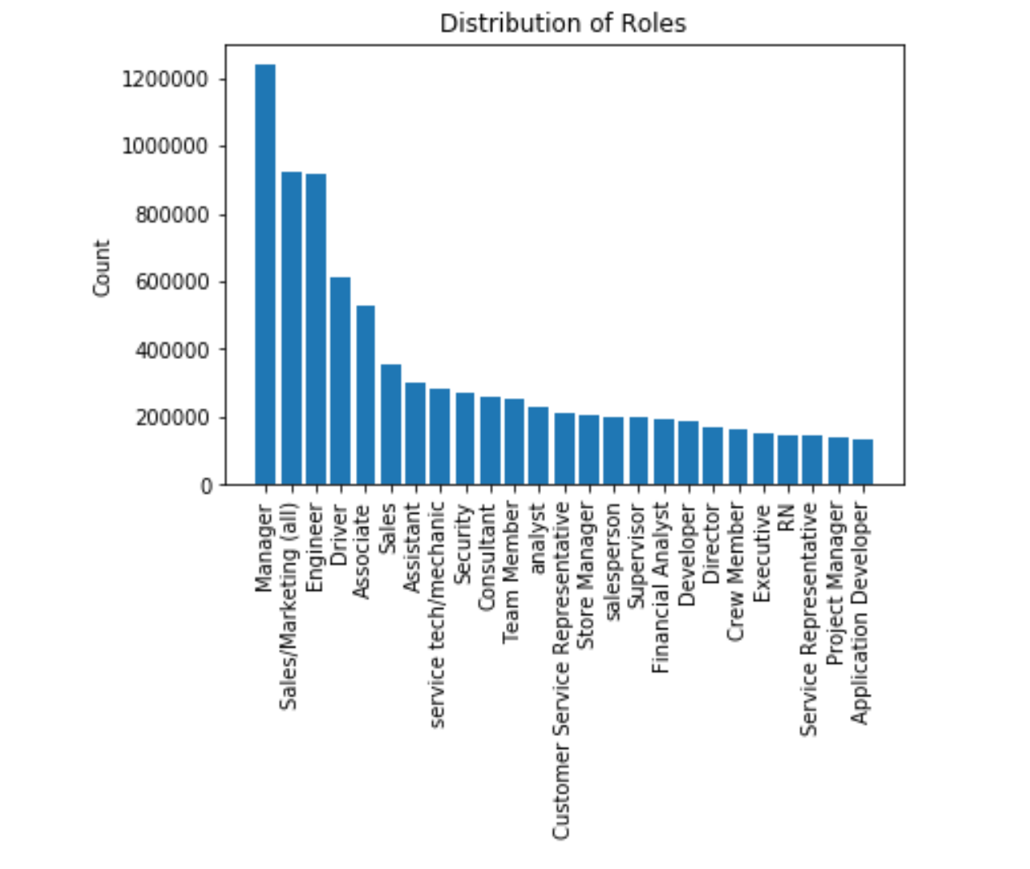
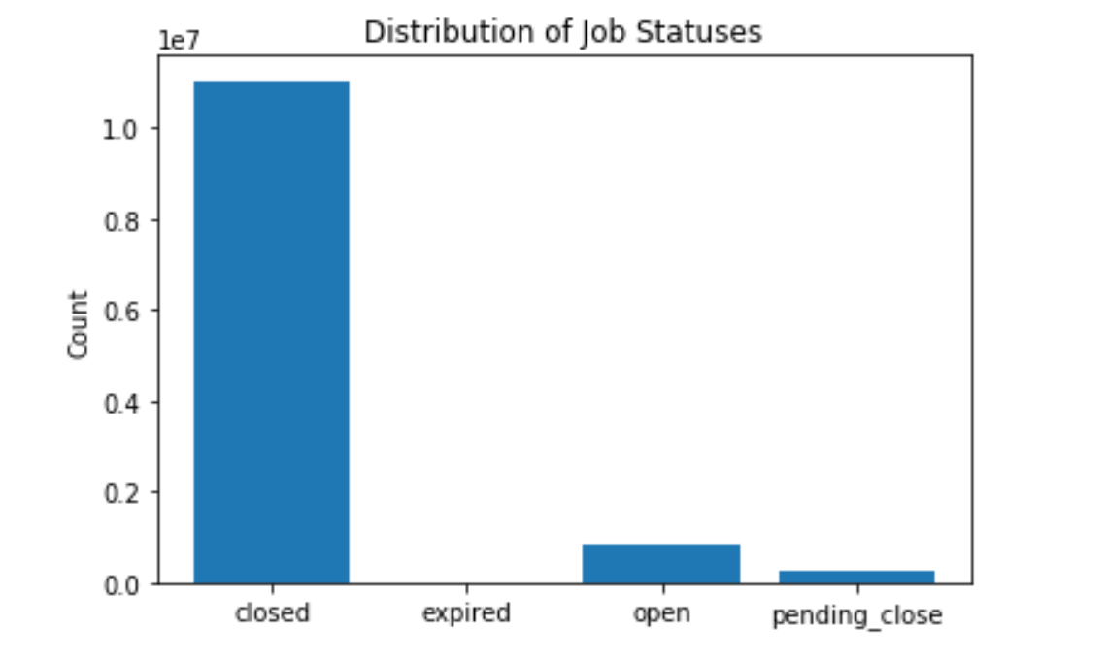
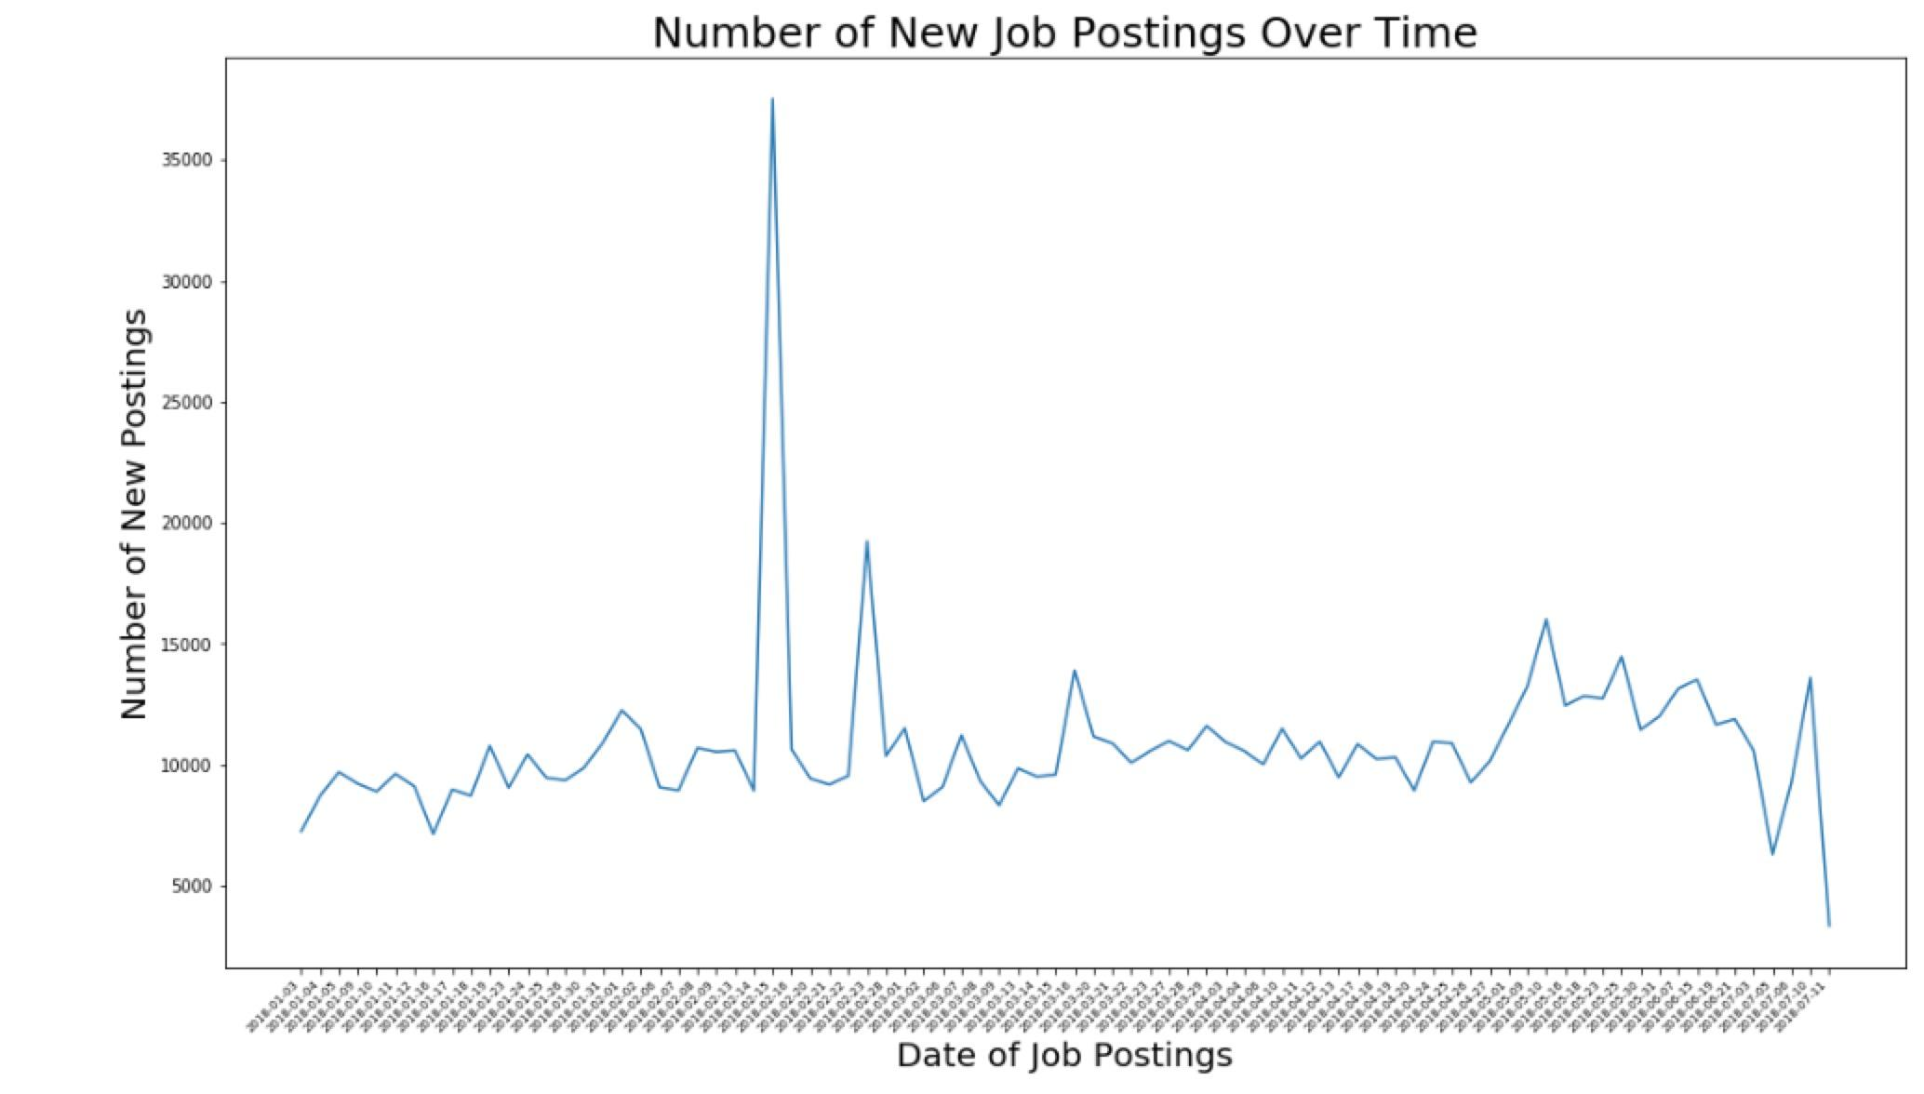
MACHINE LEARNING MODELING – DATA EXPLORATION

Slide 9
MACHINE LEARNING MODELING – INSIGHTS
Linear models allowed characterization of the ways in which a job posted by each company had different effects on the predicted stock price.
The linear regression coefficients provide a great discriminant between various types of stocks and their job posting activity, hence they were used.
The first model built was multiple linear regression, while using the "pct_change_90_stock" (or percent change in stock closing price over the last 90 days) as our dependent variable . This model resulted in an R-squared value of approximately 0.58292.
The next two models implement regularization in the form of LASSO and Ridge regressions.
Lastly, for the final validated Multiple Regression Model, the test set generated an MSE of approximately 0.013029.
 | LASSO | RIDGE
alpha | 0.001 | 0.01
R-squared | 0.52668 | 0.58292
MSE | 0.01481 | 0.013029

